Slide 1

Domain: MATLAB
Technology: COMMUNICATION
APPLICATION OF AN IMPROVED ADAPTIVE BEAMFORMING ALGORITHM FOR 5G IN PDSCH CHANNEL

Slide 2
Index
Abstract
Introduction
Literature review
Existing Method
Disadvantages
Proposed method
Advantages
Applications
Hardware and Software Requirements
Results
Conclusion
References

Slide 3
Abstract
Multiple wireless systems coexisting in a 5G network might produce interference in the same frequency band, degrading the received signal's performance. In this paper, a novel algorithm is proposed in antenna array processing to handle interference-coexistence communication. We adopt a linear filter which is called Linearly Constrained Minimum Variance (LCMV) filter. We impose a log-sum penalty on the coefficients and add it to the cost function based on classic singly linearly constrained least mean square (LC-LMS). The iterative formula for filter weights is derived. We demonstrate that the new method's convergence rate is faster than the traditional one using simulations in an antenna environment with a signal of interest, noise, and interferences. Furthermore, the proposed method's mean-square-error (MSE) is confirmed. Our technique has a lower MSE than the classic LC-LMS algorithm, according to the findings of the experiments. The suggested adaptive beam forming approach can be used in a 5G system in Physical Downlink Shared Channel to deal with signal and interference coexistence.
.

Slide 4
Introduction:
The deployment and commercial operation of 5G systems are speeding up to meet the anticipated demands of next decade in data transmission. 5G networks are emerging intelligent systems which involve the application of advanced signal processing ,D2D , internet of things (IOT), edge computing , and wireless access technologies that have drawn much attention in recent years. In a 5G network, coexistence of multiple wireless systems can cause interference in the same frequency band and deteriorate the received signal. The anti-interference communication will still play an important role in the network. The adaptive beam forming technology has always been an import part in antenna processing to handle interference problem. The direction information is added into the transmitted signal with the technology and then the mixed signal, including signal of interest(SOI), interferences and noise, is received at receive end. Actually, SOI have different Direction of Arrival(DOA) compared with interferences. Adaptive algorithms ensure to produce null points towards the directions of interferences while maintain the gain of SOI.

Slide 5
Introduction:
The PDSCH uses Orthogonal Frequency Division Multiplexing (OFDM) modulation to transmit data over multiple subcarriers in the frequency domain. The data is organized into Transport Blocks (TBs), which are then further divided into smaller units called Code Blocks (CBs) for transmission. The PDSCH supports several transmission modes, which are used to optimize the transmission of data based on the channel conditions and UE capabilities.
The PDSCH uses Orthogonal Frequency Division Multiplexing (OFDM) modulation to transmit data over multiple subcarriers in the frequency domain. The data is organized into Transport Blocks (TBs), which are then further divided into smaller units called Code Blocks (CBs) for transmission. The PDSCH supports several transmission modes, which are used to optimize the transmission of data based on the channel conditions and UE capabilities.

Slide 6
Introduction:
To ensure reliable transmission of data, the PDSCH uses a number of techniques to mitigate errors and interference. These include channel coding, which adds redundancy to the data to enable error correction, and adaptive modulation and coding, which adjusts the modulation scheme and coding rate based on the channel conditions.

Slide 7
Literature review:
S. NO | Journal Type with year | Authors | Title | Outcomes
1 | IEICE Trans. Commun., vol. E101-B, no. 4, pp. 1108–1115, Apr. 2018. | S. Wang, Y. Wang, B. Xu, Y. Li, and W. | “Capacity of two-way in-band full-duplex relaying with imperfect channel state information” | Studied about IBFD and half-duplex modes
2 | IEEE Trans. on Veh. Technol., | Z. Zhao, S. Bu, T. Zhao, Z. Yin, M. Peng, Z. Ding, and Tony Q. S. Quek | “On the design of computation offloading in fog radio access networks” | Studied about enlarge the performance gains of the NOMA-MC scheme
3 | IEEE Trans. Speech Audio Process., vol. 8, pp. 508C- 518, 2000. | D.L. Duttweiler | “Proportionate normalized least-mean squares adaptation in echo cancelers” | Studied about LEACH outperforms static clustering algorithms
4 | Proceeding of the IEEE International Conference on Acoustics, Speech and Signal Processing, 2009, pp. 3125–3128 | Y. Chen,Y. Gu,and A. O. Hero | “Sparse lms for system identification” | Studied about the RZA-LMS
5 | J. Fourier Anal. Appl.. | E. J. Cand‘ es, M. Wakin, and S. Boyd, | “Enhancing sparsity by reweighted l1 minimization” | Studied about a Compressive Sensing

Slide 8
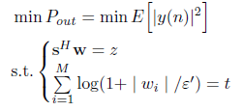

Existing methods :
On the basis of traditional ,singly linearly constrained least mean square (LC-LMS), we introduce a log-sum penalty on the coefficients and add it into the cost function. We derive the iterative formula of filter weights. By simulations in antenna environment with signal of interest, noise and interferences. In this part, we give the specific derivations of the new algorithm. The newly proposed algorithm adds log-sum penalty to the object function on the basis of LC-LMS. The optimization problem is expressed as follows
Similarly, through steepest descend method, we get

Slide 9
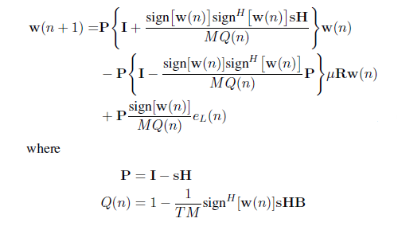
Existing methods :
Here, we use modulus value of coefficient w(n) to show the convergence rate. Steady state is characterized by MSE.

Slide 10
Disadvantages in Existing methods:
Complexity: An improved algorithm may be more complex than traditional approaches, requiring more computational resources and potentially increasing the overall system complexity.
Implementation challenges: An improved algorithm may require additional hardware or software resources, and may be more difficult to implement and test in real-world scenarios.
Trade-offs: An improved algorithm may require trade-offs between different performance metrics, such as interference suppression and beamforming accuracy, leading to challenges in optimizing the algorithm for specific use cases.

Slide 11
Proposed method :
On the basis of traditional ,singly linearly constrained least mean square (LC-LMS), we introduce a log-sum penalty on the coefficients and add it into the cost function. We derive the iterative formula of filter weights. By simulations in antenna environment with signal of interest, noise and interferences. In this part, we give the specific derivations of the new algorithm. The newly proposed algorithm adds log-sum penalty to the object function on the basis of LC-LMS. The optimization problem is expressed as follows
Similarly, through steepest descend method, we get

Slide 12
Proposed method :
Channel Coding: The input data bits, d, are channel encoded using a cyclic redundancy check (CRC) and a forward error correction (FEC) code, resulting in a set of coded bits, c.
Modulation: The coded bits, c, are modulated onto a set of complex symbols, s, using a specific modulation scheme, such as QPSK, 16-QAM, or 64-QAM. The modulation scheme determines the number of bits per symbol and the constellation used to map the bits onto the complex plane.
Resource Mapping: The modulated symbols, s, are mapped onto a set of resource elements (REs), which are the basic units of transmission in the frequency and time domains. The mapping is done based on the physical layer parameters, including the resource grid size, subcarrier spacing, and cyclic prefix length.
Precoding: The mapped symbols, s, are precoded using a specific precoding matrix, W, which is designed to optimize the transmission of data based on the channel conditions and user equipment (UE) capabilities. The precoding matrix can be based on a variety of techniques, such as maximum ratio combining (MRC) or zero forcing (ZF).
Signal Generation: The precoded symbols, s', are combined into a single signal, x, which is then transmitted over the PDSCH channel.

Slide 13
Methodology
The adaptive beamforming technique with logsum penalty will be implemented in the Physical Downlink Shared Channel (PDSCH), the beamforming technique will takes the codewords that are modified from the channel encoder will reduce the noise among the users.
The encoded codewords then, transmitted towards modulator which may consists of QAM, QPSK etc. will modulate the codewords and transmit with a very high datarate.
The codewords will then be mapped to the users as resource elements. The resource elements will then be used for allocating resources for the users.
The resource elements are used for the accessing of resources in a memory frame.
The resource elements are precoded to minimize the interference among users.
The precoded resource elements are combined to form a single signal through which the resource elements will transmitted over the physical downlink shared channel (PDSCH).

Slide 14
Advantages of Proposed method:
High Data Rates.
Resource Sharing
Adaptive Modulation and Coding
Efficient Resource Allocation
Low Latency
Improved Coverage

Slide 15
Applications:
1 Applied in 5G system.
2. System Identification.
3.Inverse Modeling.
4.Prediction.
5.Echo Cancellation.

Slide 16
Hardware and Software Requirements:
Hardware & Software Requirements:
Software: Matlab R2018a.
Hardware:
Operating Systems:
• Windows 10
• Windows 7 Service Pack 1
• Windows Server 2019
• Windows Server 2016
Processors:
Minimum: Any Intel or AMD x86-64 processor
Recommended: Any Intel or AMD x86-64 processor with four logical cores and AVX2 instruction set support
Disk:
Minimum: 2.9 GB of HDD space for MATLAB only, 5-8 GB for a typical installation
Recommended: An SSD is recommended a full installation of all Math Works products may take up to 29 GB of disk space
RAM:
Minimum: 4 GB
Recommended: 8 GB

Slide 17
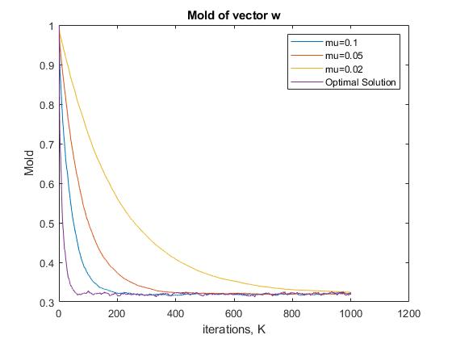
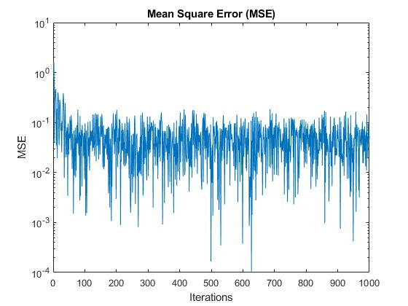
Results
Fig: Mold of Vector w
Fig: Mean Square Error (MSE)

Slide 18
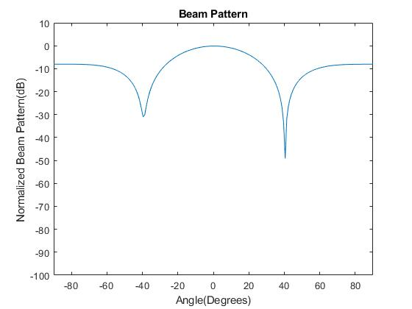
Fig: Final Beam Pattern

Slide 19
References:
[1] S. Wang, Y. Wang, B. Xu, Y. Li, and W. Xu, “Capacity of two-way in-band full-duplex relaying with imperfect channel state information,” IEICE Trans. Commun., vol. E101-B, no. 4, pp. 1108–1115, Apr. 2018.
[2] S. Wang, D. D Wang, C. Li, and W. B Xu. “Full Duplex AF and DF Relaying Under Channel Estimation Errors for V2V Communications,” IEEE Access. vol. 6, pp. 65321-65332, Nov., 2018.
[3] Z. Zhao, S. Bu, T. Zhao, Z. Yin, M. Peng, Z. Ding, and Tony Q. S. Quek, “On the design of computation offloading in fog radio access networks,” to appear in IEEE Trans. on Veh. Technol., [Online] Availiable:https://ieeexplore.ieee.org/document/8730522.
[4] Z. Zhao, M. Xu, Yong Li, and M. Peng, “A non-orthogonal multiple access-based multicast scheme in wireless content caching networks,” IEEE J. Sel. Areas Commun., vol. 35, no. 12, pp. 2723–2735, July 2017.
[5] B. Widrow and S. D. Stearns, Adaptive Signal Processing, New Jersey: Prentice Hall, 1985.

